Slide 1


Slide 2
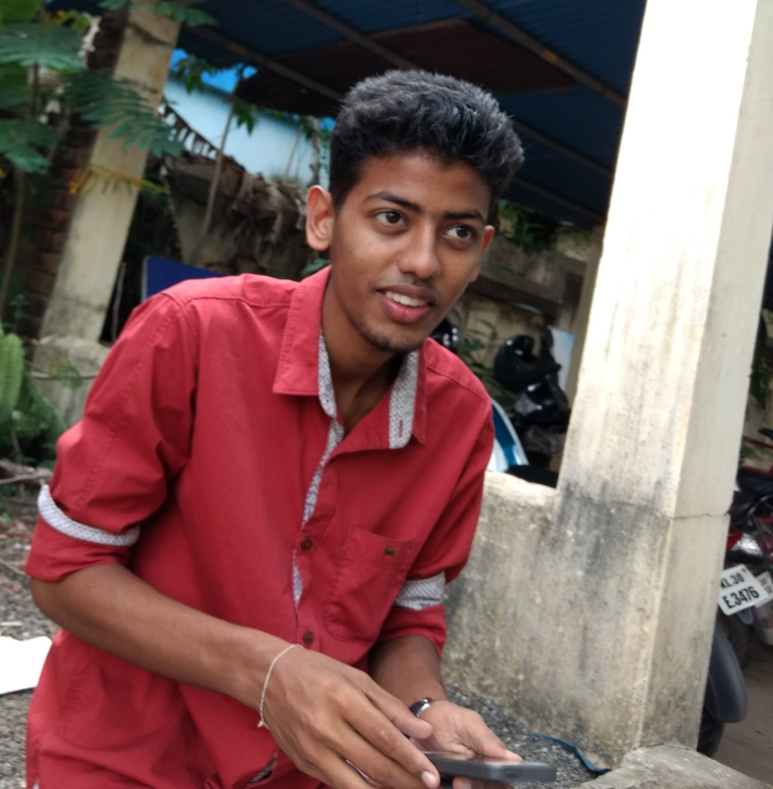
Proxy set aayoda??

Slide 3











Slide 4





Slide 5
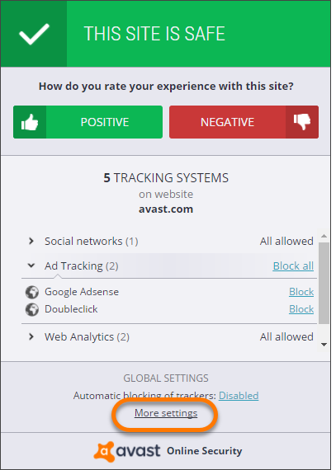

Slide 6
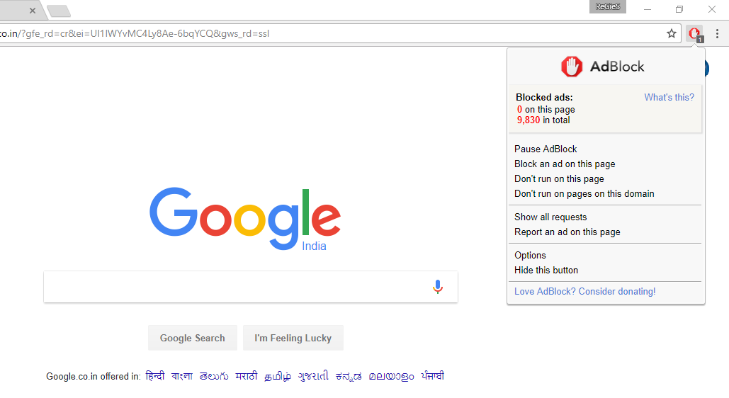

Slide 7






Slide 8









Slide 9








Slide 10








Slide 11












Slide 12



Slide 13

Securely
WE COULDN’T THINK OF a CATCH PHRASE :P

Slide 14

We’re gonna help you know more and stay safe in this predating online world And tell you stuff you probably didn’t know and everything new that’s happening in the world of tech.

Slide 15

നന്ദി നമസ്കാരം

